Slide 1
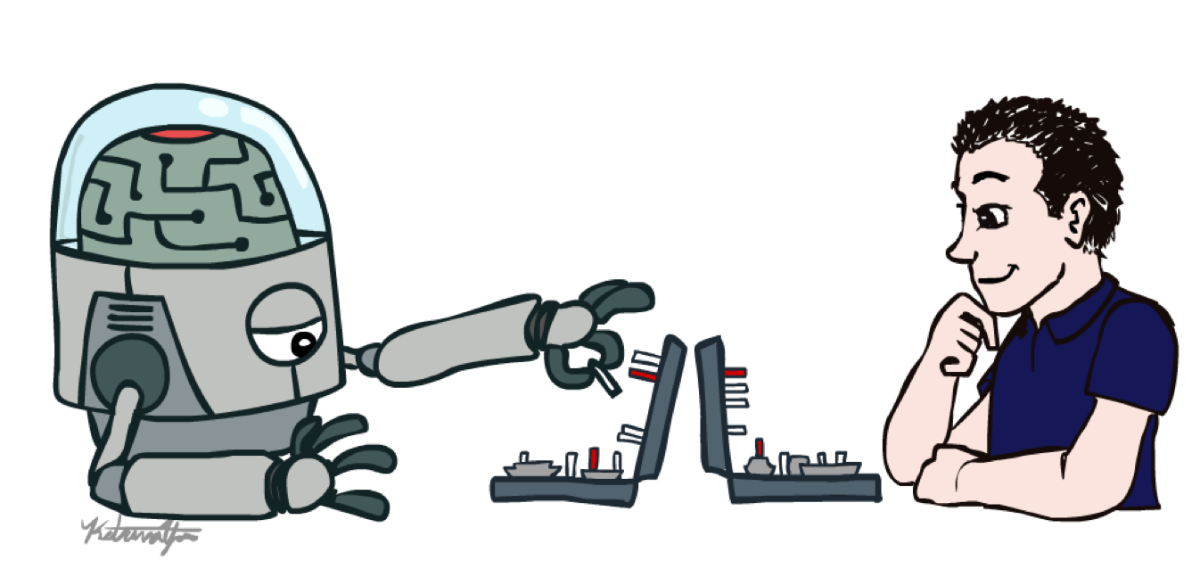
2022 Winter
UPDATA AI Study
Chap 4. Adversarial Search
Image from CS188 of Klein and Abbee

Slide 2
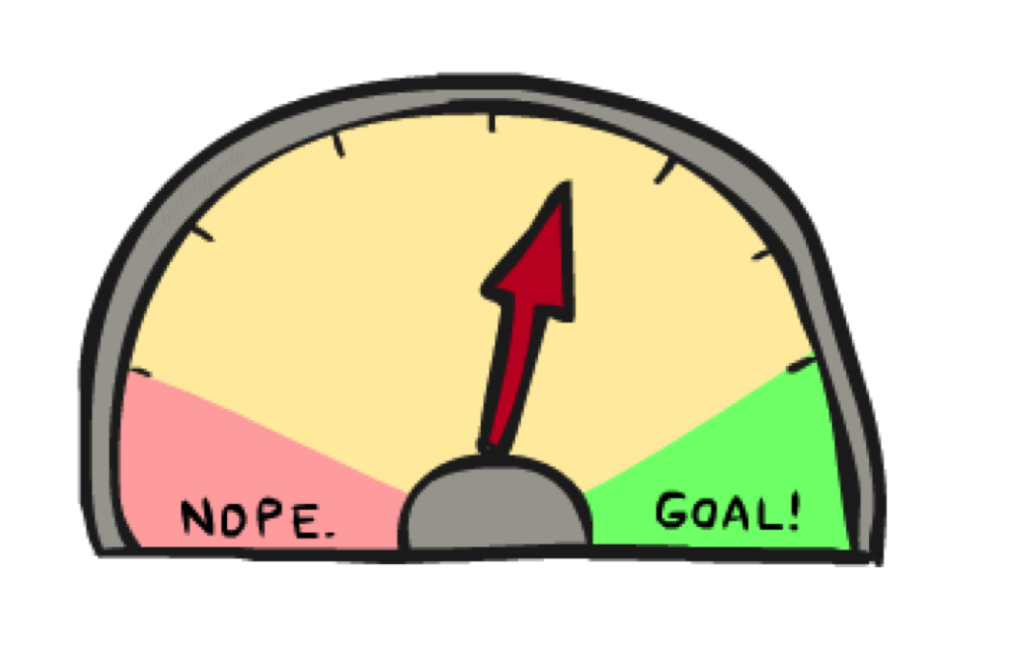
Adversarial Games
Image from CS188 of Klein and Abbee

Slide 3
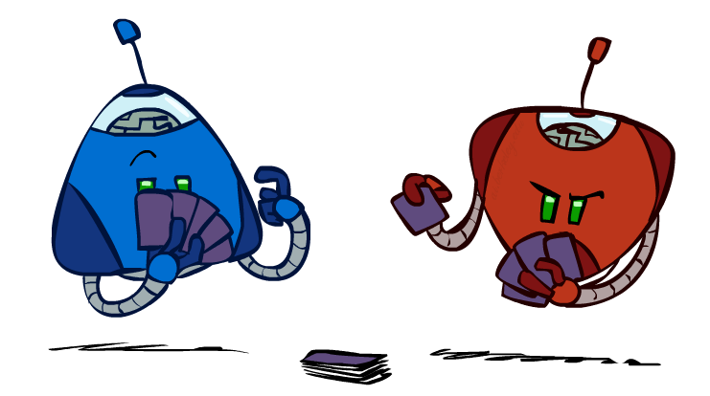
Type of Games
Many different kinds of games!
Axes:
Deterministic or stochastic?
One, two, or more players?
Zero sum?
Perfect information (can you see the state)?
Want algorithms for calculating a strategy (policy) which recommends a move from each state
Slide credit: CS188 of Klein and Abbee

Slide 4
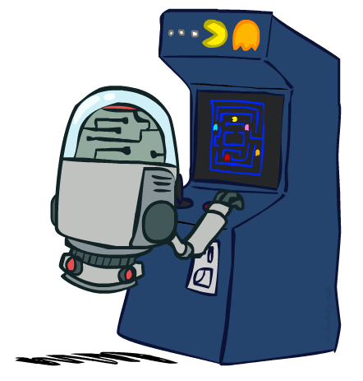
Deterministic Games
Many possible formalizations, one is:
States: S (start at s₀)
Players: P={1...N} (usually take turns)
Actions: A (may depend on player / state)
Transition Function: SxA → S
Terminal Test: S → {t,f}
Terminal Utilities: SxP → R
Solution for a player is a policy: S → A
Slide credit: CS188 of Klein and Abbee

Slide 5
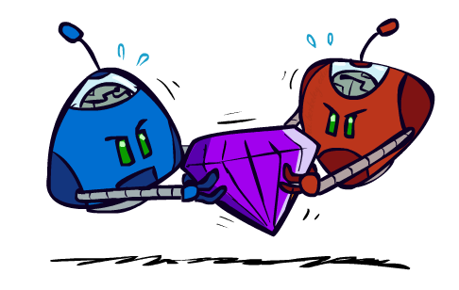
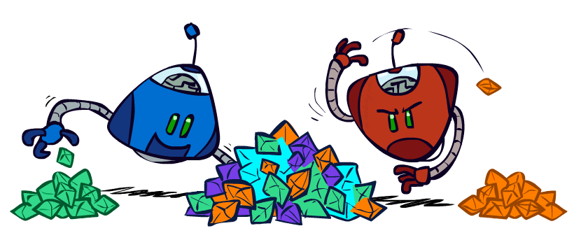
Zero-Sum Games
Zero-Sum Games
Agents have opposite utilities (values on outcomes)
Lets us think of a single value that one maximizes and the other minimizes
Adversarial, pure competition
General Games
Agents have independent utilities (values on outcomes)
Cooperation, indifference, competition, and more are all possible
More later on non-zero-sum games
Adapted from: CS188 of Klein and Abbeel

Slide 6

Adverserial Search
Slide credit: CS188 of Klein and Abbee

Slide 7
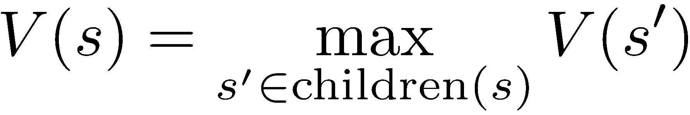
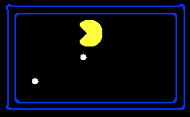
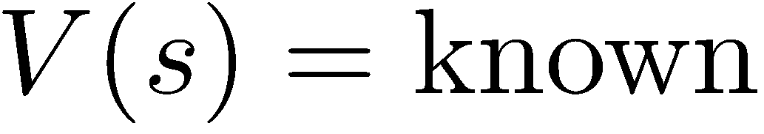
Value of a State
Value of a state: The best achievable outcome (utility) from that state
Non-Terminal States:
8
2
0
…
2
6
…
4
6
Terminal States:
Slide credit: Klein and Abbee

Slide 8

Adversarial Search
-20
-8
…
-18
-5
…
-10
+4
-20
+8
Slide credit: Klein and Abbee

Slide 9
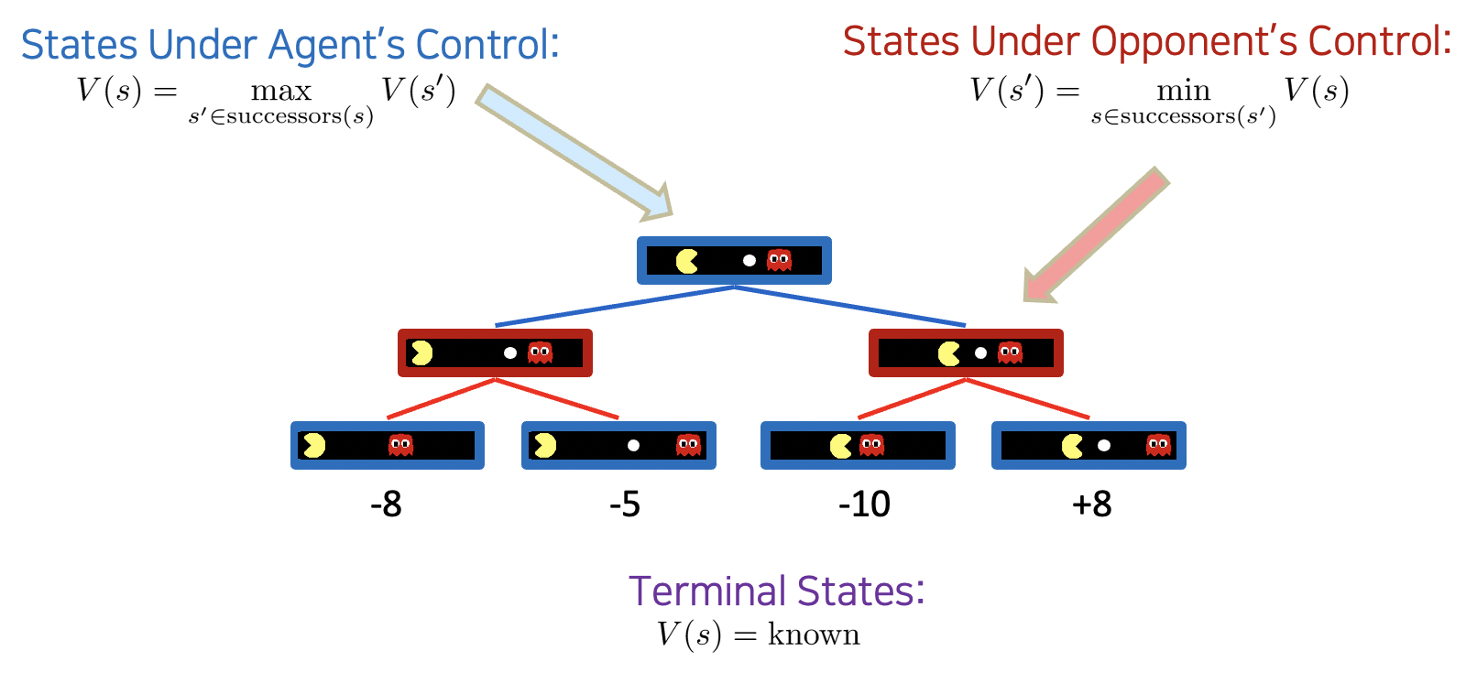
Minimax Values
Slide credit: Klein and Abbee

Slide 10
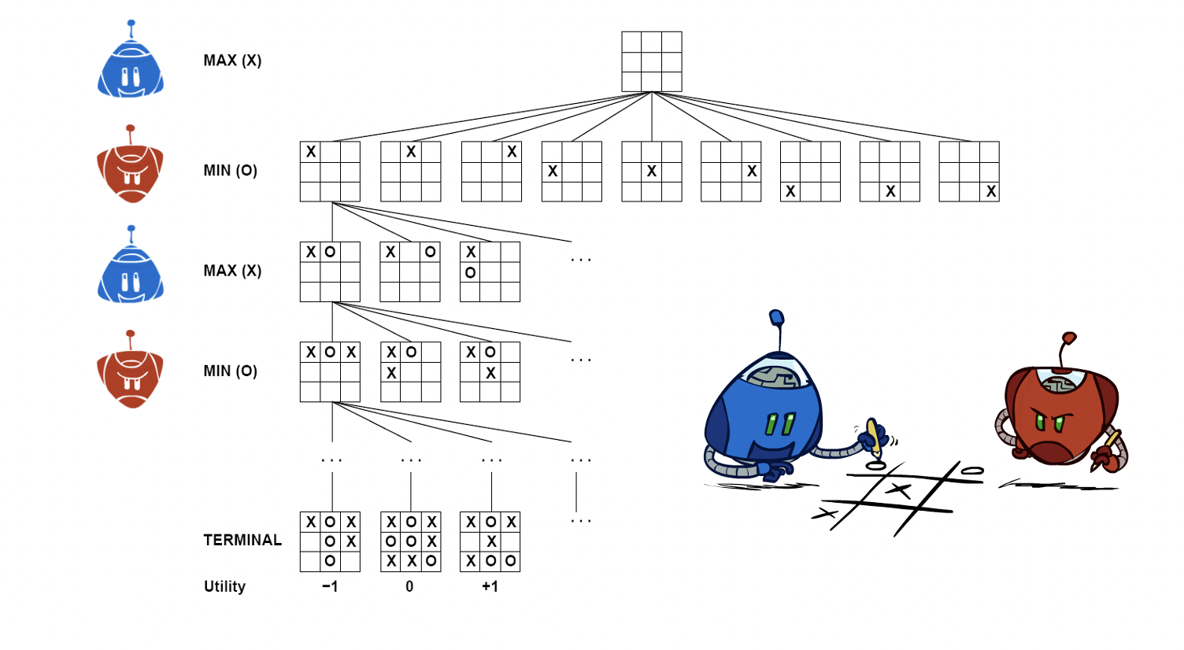
Tic-Tac-Toe Game Tree
Slide credit: Klein and Abbee

Slide 11
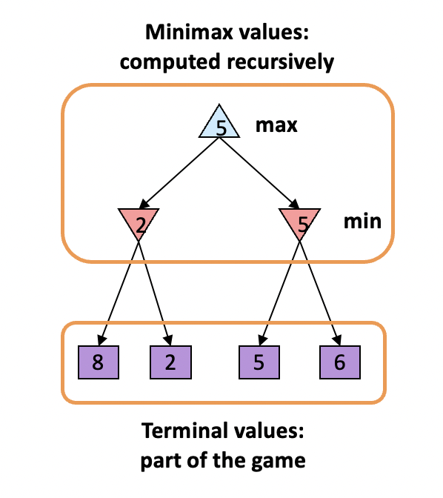
Adversarial Search (Minimax)
Deterministic, zero-sum games:
Tic-tac-toe, chess, checkers
One player maximizes result
The other minimizes result
Minimax search:
A state-space search tree
Players alternate turns
Compute each node’s minimax value: the best achievable utility against a rational (optimal) adversary
Slide credit: Klein and Abbee

Slide 12
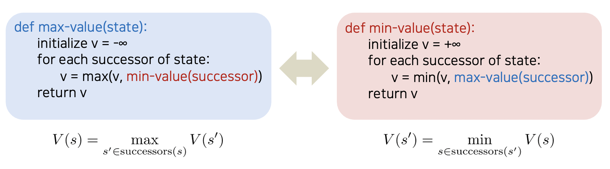
Minimax implementation
Slide credit: Klein and Abbee

Slide 13
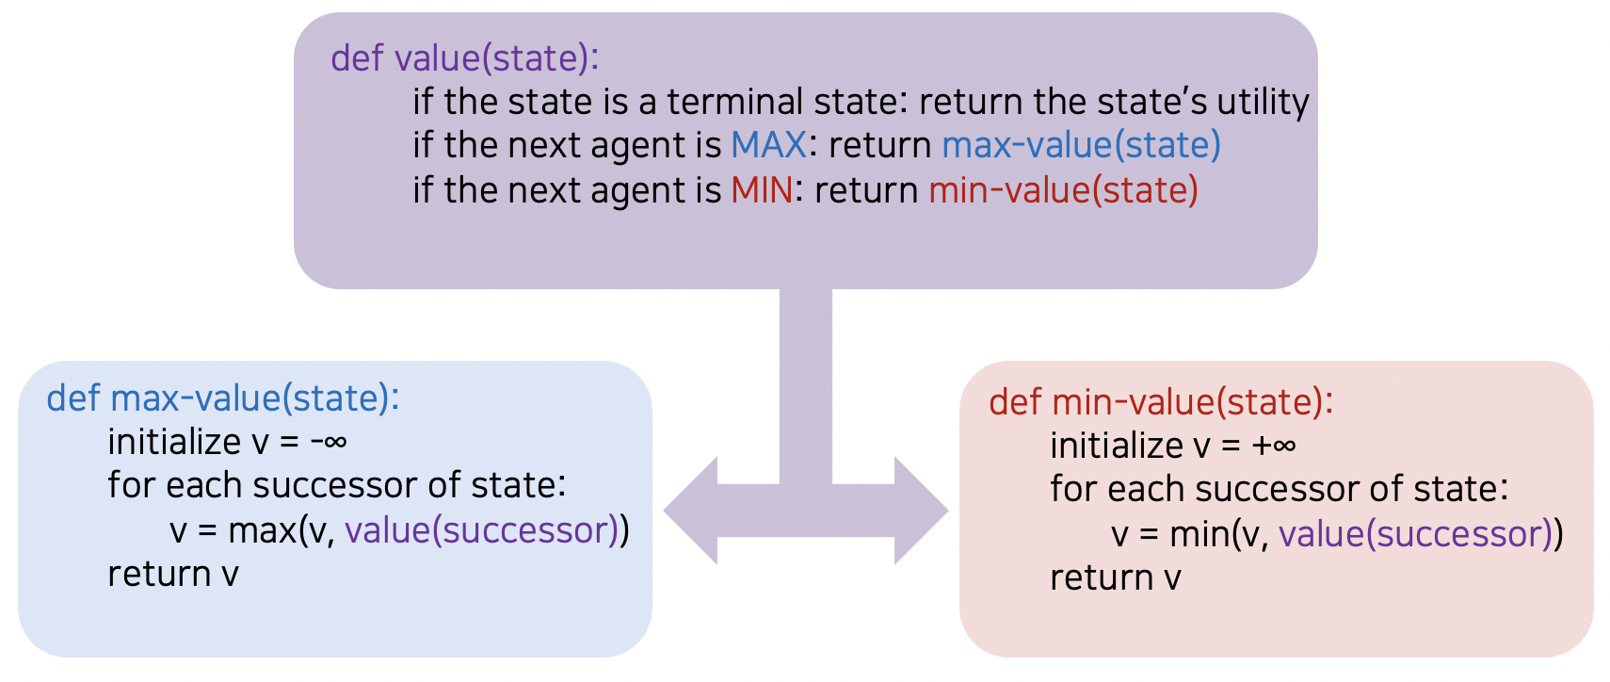
Minimax implementation
Slide credit: Klein and Abbee

Slide 14
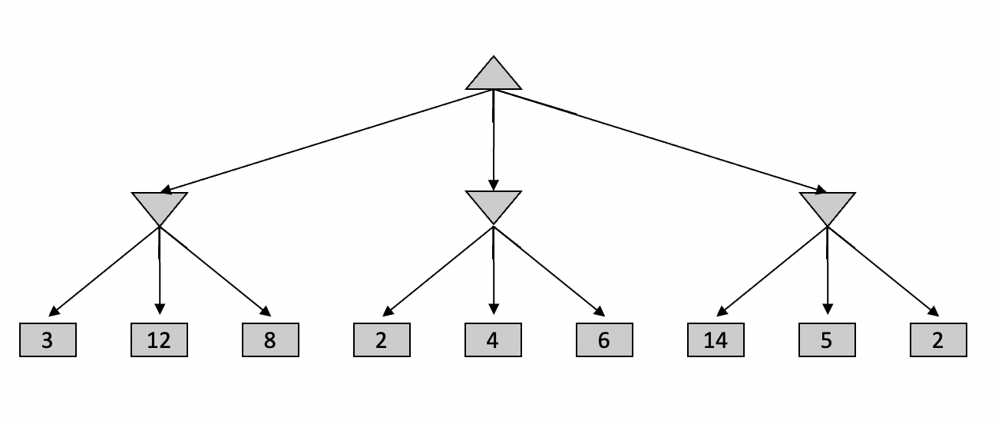
Minimax Example
max
min
Slide credit: Klein and Abbee

Slide 15
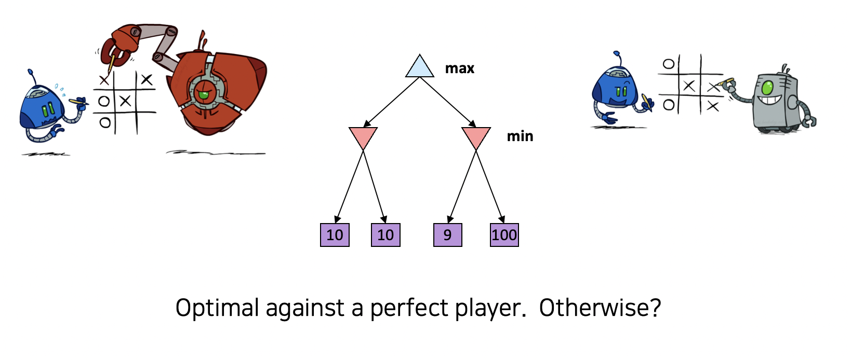
Minimax Properties
Slide credit: Klein and Abbee

Slide 16
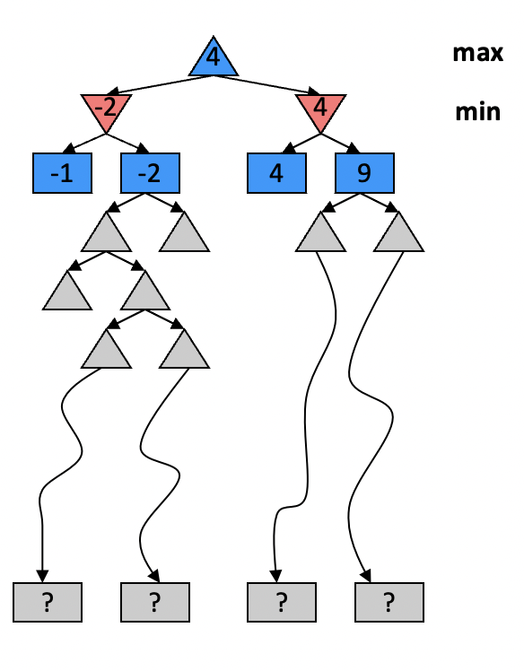
Resource Limits
Problem: In realistic games, cannot search to leaves!
Solution: Depth-limited search
Instead, search only to a limited depth in the tree
Replace terminal utilities with an evaluation function for non-terminal positions
Example:
Suppose we have 100 seconds, can explore 10K nodes / sec
So can check 1M nodes per move
α-β reaches about depth 8 – decent chess program
Guarantee of optimal play is gone
More plies makes a BIG difference
Use iterative deepening for an anytime algorithm
Slide credit: Klein and Abbee

Slide 17
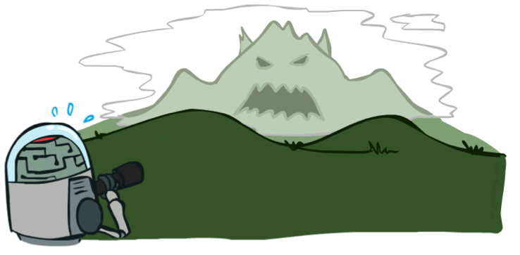
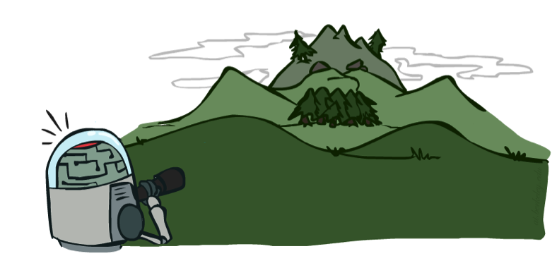
Depth Matters
Evaluation functions are always imperfect
The deeper in the tree the evaluation function is buried, the less the quality of the evaluation function matters
An important example of the tradeoff between complexity of features and complexity of computation
Slide credit: Klein and Abbee

Slide 18
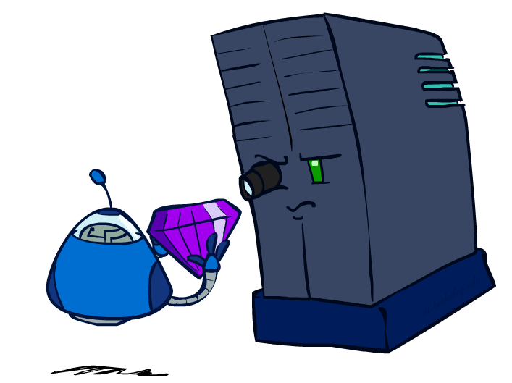
Evaluation Functions
Slide credit: Klein and Abbee

Slide 19
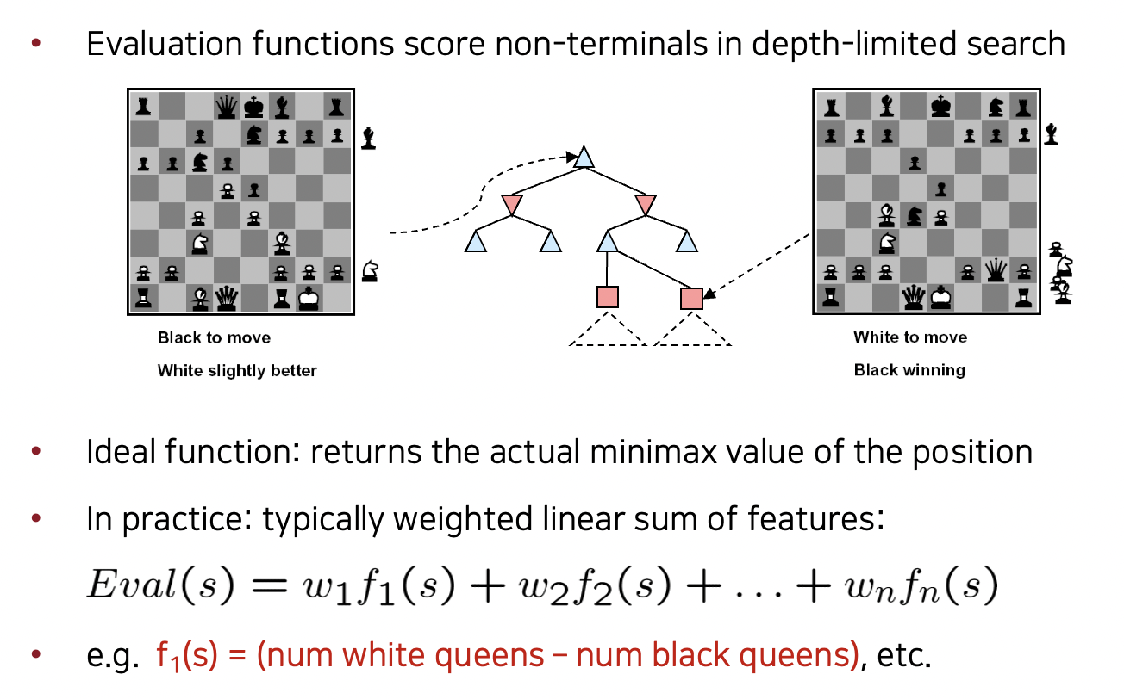
Evaluation Functions
Slide credit: Klein and Abbee

Slide 20
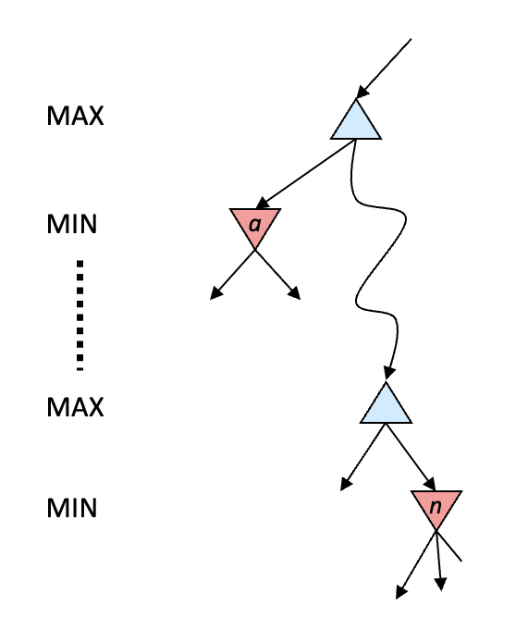
Alpha-Beta Prunning
General configuration (MIN version)
We’re computing the MIN-VALUE at some node n
We’re looping over n’s children
n’s estimate of the childrens’ min is dropping
Who cares about n’s value? MAX
Let a be the best value that MAX can get at any choice point along the current path from the root
If n becomes worse than a, MAX will avoid it, so we can stop considering n’s other children (it’s already bad enough that it won’t be played)
MAX version is symmetric
Slide credit: Klein and Abbee

Slide 21
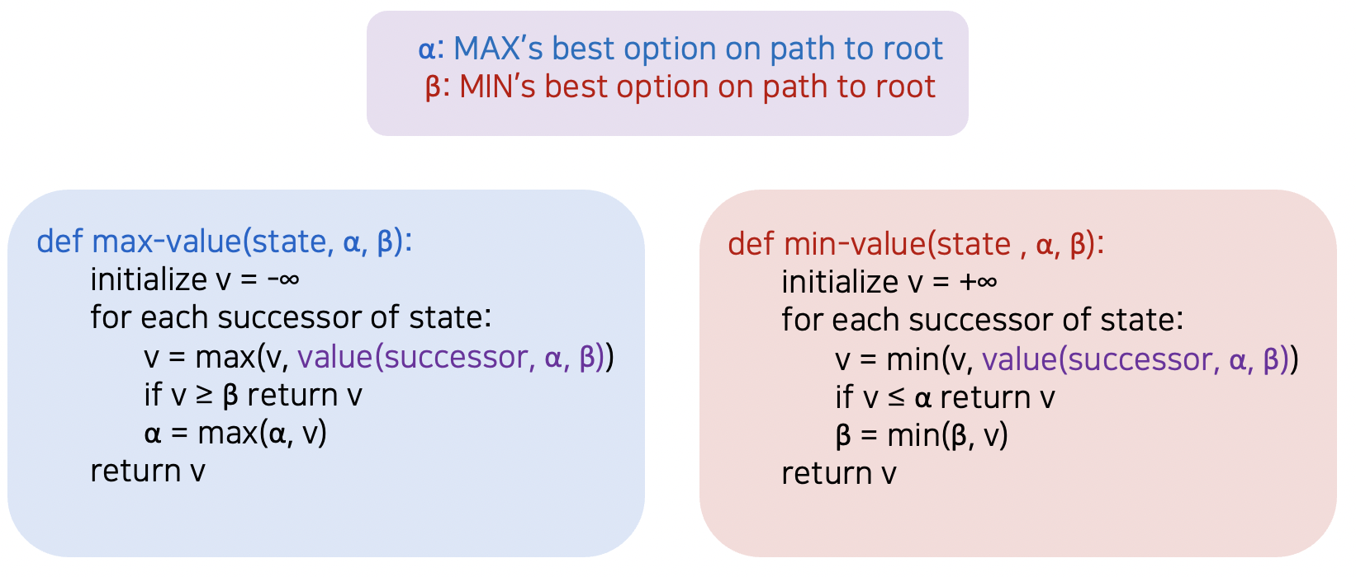
Alpha-Beta Prunning Implementation
Slide credit: Klein and Abbee

Slide 22
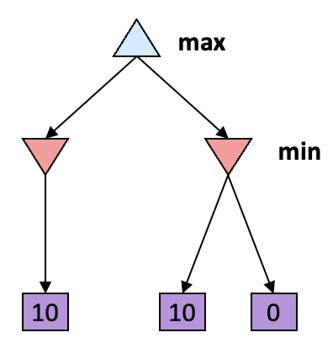
Alpha-Beta Prunning Properties
This pruning has no effect on minimax value computed for the root!
Values of intermediate nodes might be wrong
Important: children of the root may have the wrong value
So the most naïve version won’t let you do action selection
Good child ordering improves effectiveness of pruning
With “perfect ordering”:
Time complexity drops to O(b^{m/2})
Doubles solvable depth!
Full search of, e.g. chess, is still hopeless…
This is a simple example of metareasoning (computing about what to compute)
Slide credit: Klein and Abbee

Slide 23
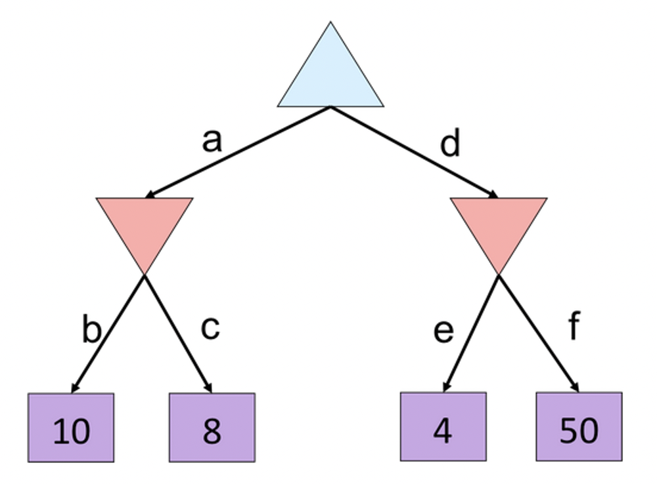
Alpha-Beta Prunning Quiz
Slide credit: Klein and Abbee

Slide 24
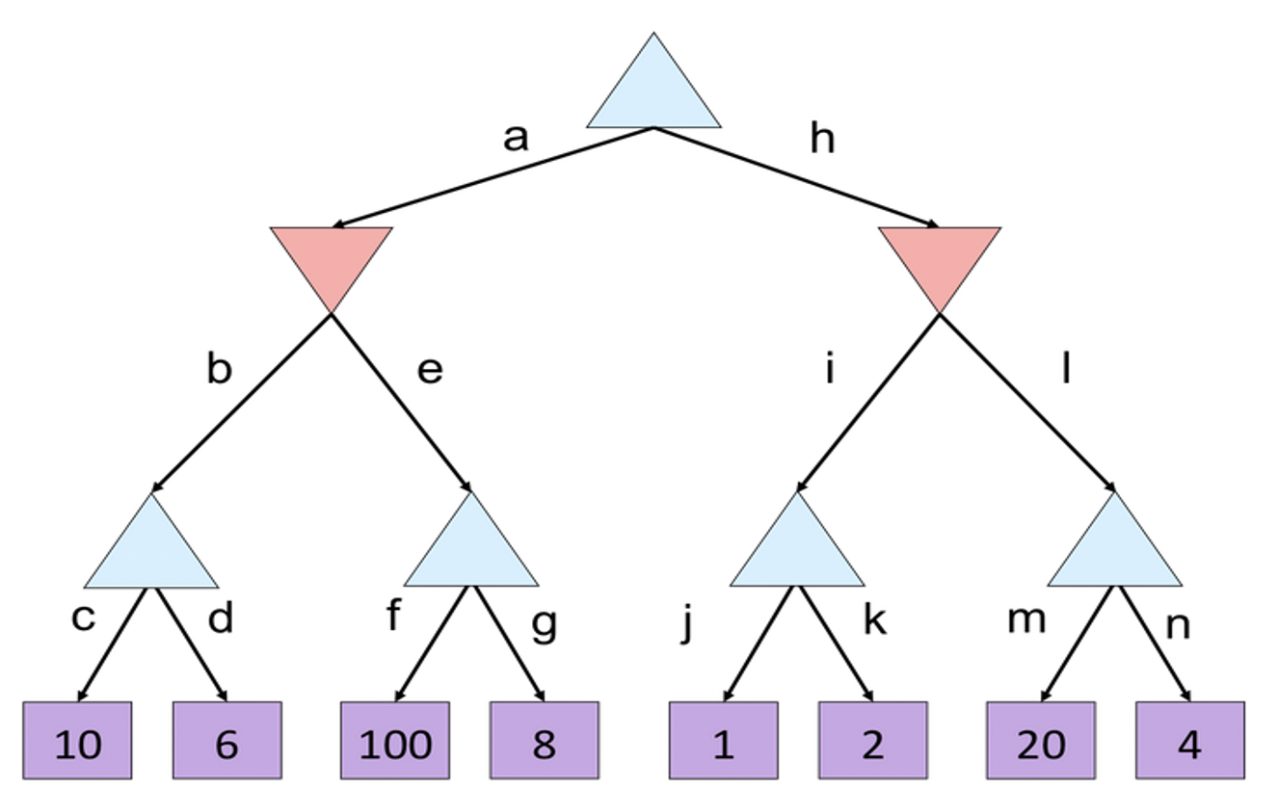
Alpha-Beta Prunning Quiz2
Slide credit: Klein and Abbee

Slide 25
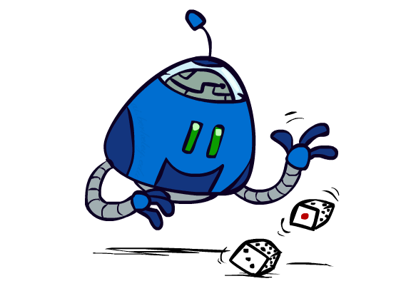
Uncertain Outcomes
Slide credit: Klein and Abbee

Slide 26
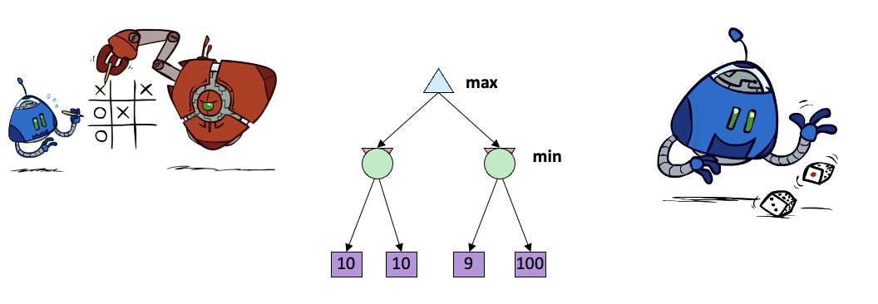
Worst Case vs Average Case
Idea: Uncertain outcomes controlled by chance, not an adversary!
Slide credit: Klein and Abbee

Slide 27
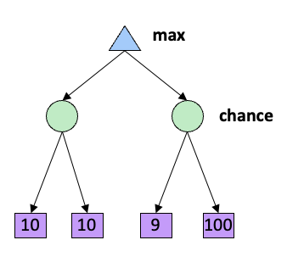
Expectimax Search
Why wouldn’t we know what the result of an action will be?
Explicit randomness: rolling dice
Unpredictable opponents: the ghosts respond randomly
Actions can fail: when moving a robot, wheels might slip
Values should now reflect average-case (expectimax) outcomes, not worst-case (minimax) outcomes
Expectimax search: compute the average score under optimal play
Max nodes as in minimax search
Chance nodes are like min nodes but the outcome is uncertain
Calculate their expected utilities
I.e. take weighted average (expectation) of children
Later, we’ll learn how to formalize the underlying uncertain-result problems as Markov Decision Processes
Slide credit: Klein and Abbee

Slide 28
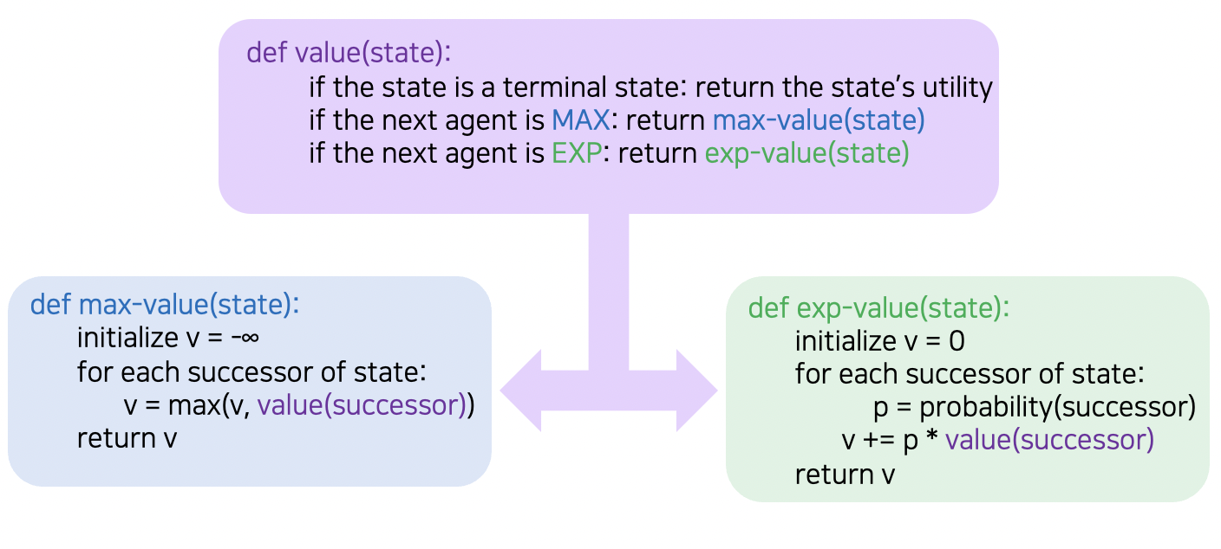
Expectimax Implementation
Slide credit: Klein and Abbee

Slide 29
Expectimax Example
3
12
9
2
4
6
15
6
0
Slide credit: Klein and Abbee

Slide 30
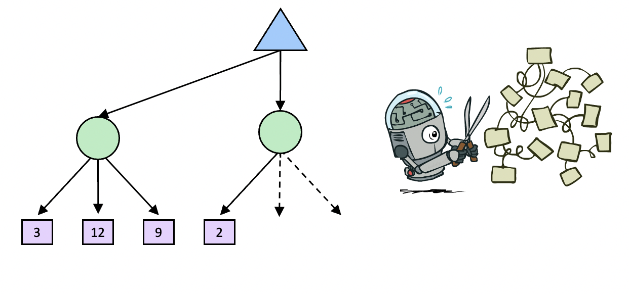
Expectimax Pruning?
Slide credit: Klein and Abbee

Slide 31
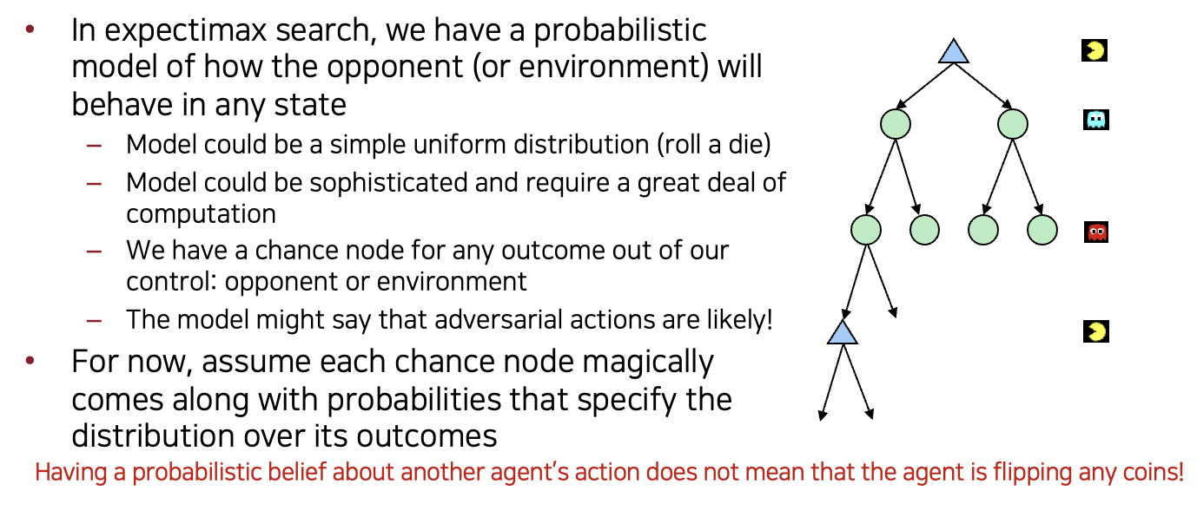
What Probabilities to Use?
Slide credit: Klein and Abbee

Slide 32
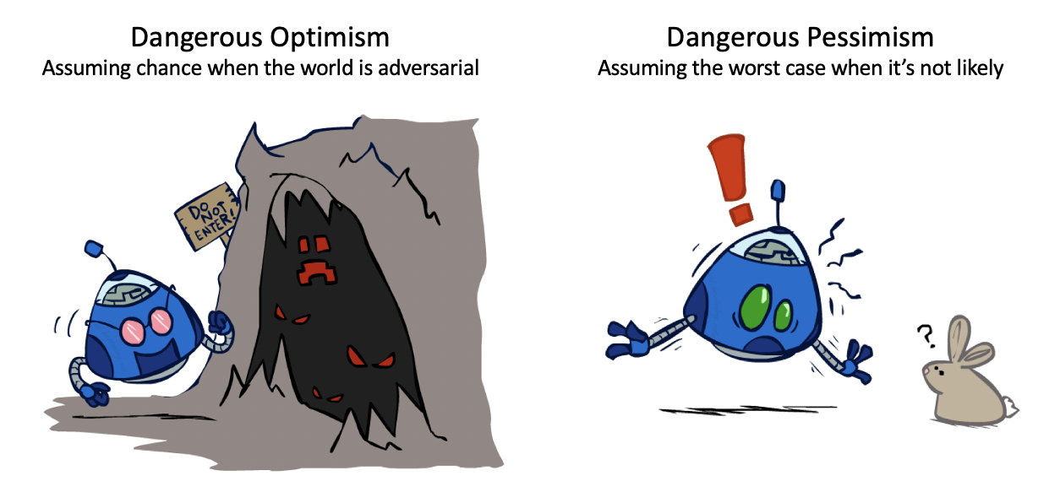
The Dangerous of Optimism and Pessimism
Slide credit: Klein and Abbee

Slide 33
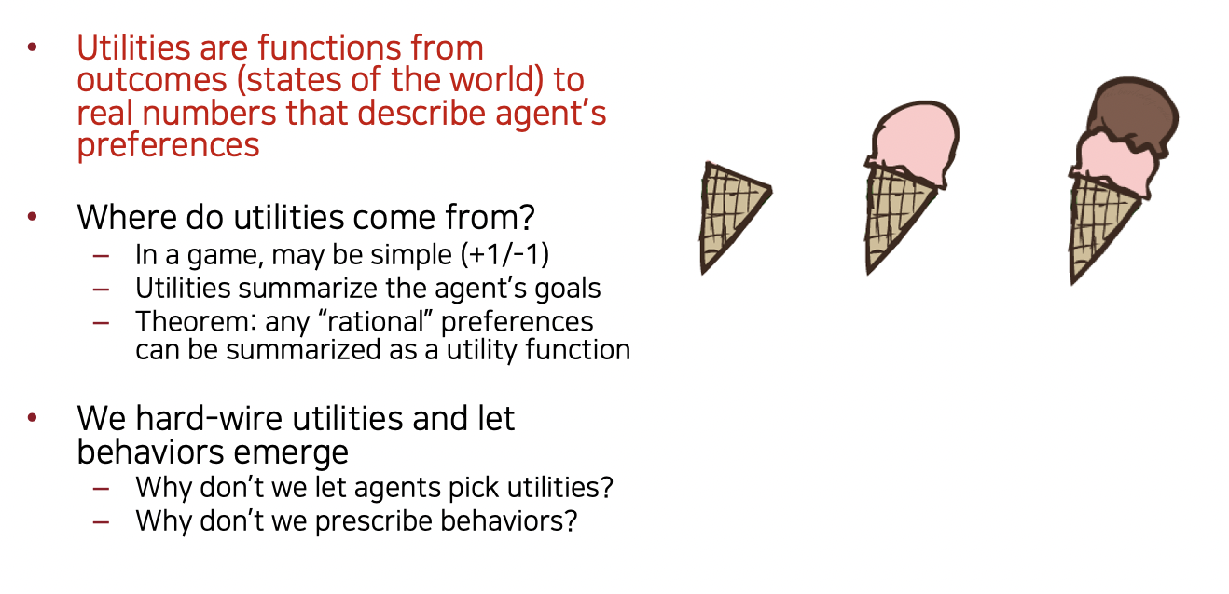
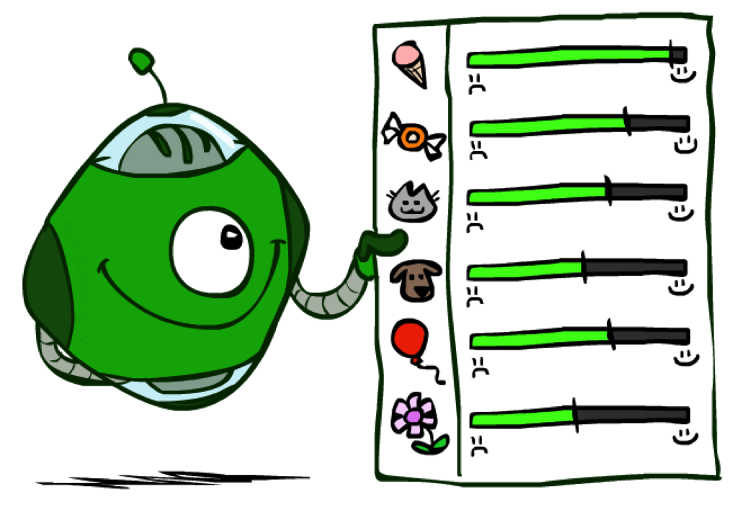
Utilities
Slide credit: Klein and Abbee

Slide 34
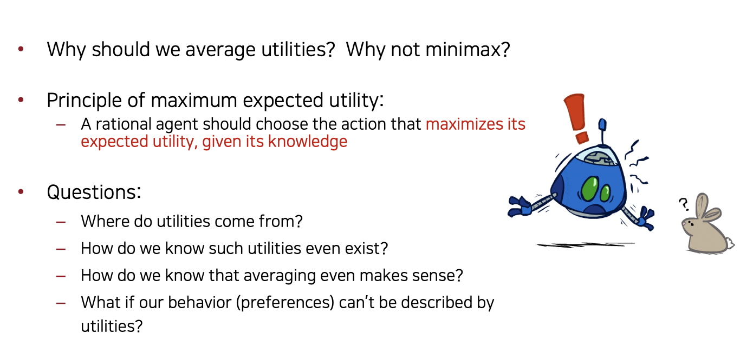
Maximum Expected Utility
Slide credit: Klein and Abbee

Slide 35
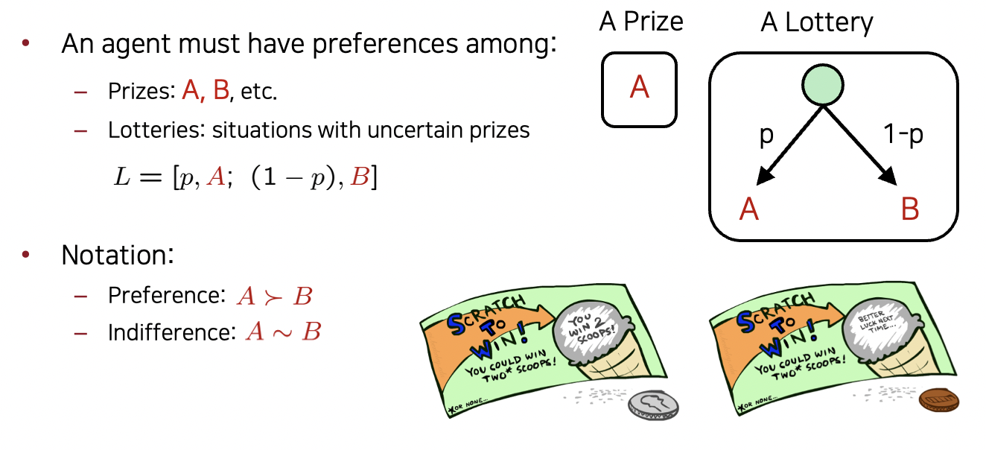
Preferencse
Slide credit: Klein and Abbee

Slide 36
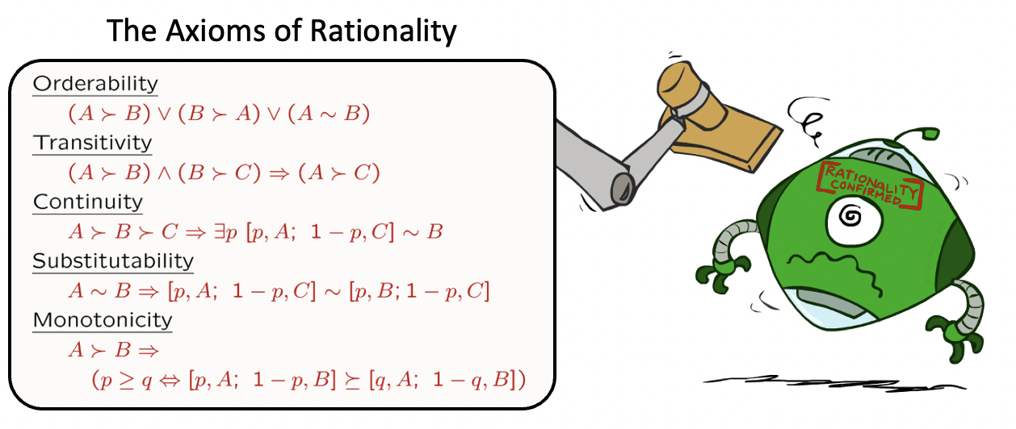
Rational Preferences
Slide credit: Klein and Abbee

Slide 37
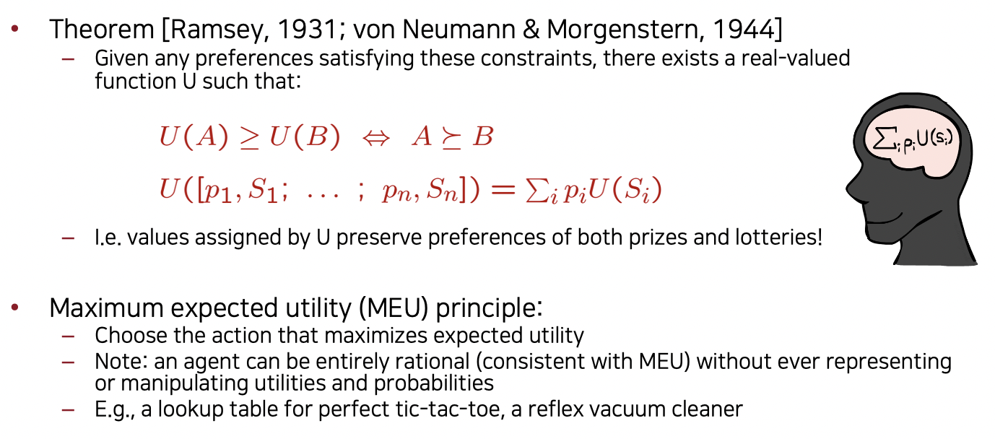
MEU Principle
Slide credit: Klein and Abbee

Slide 38
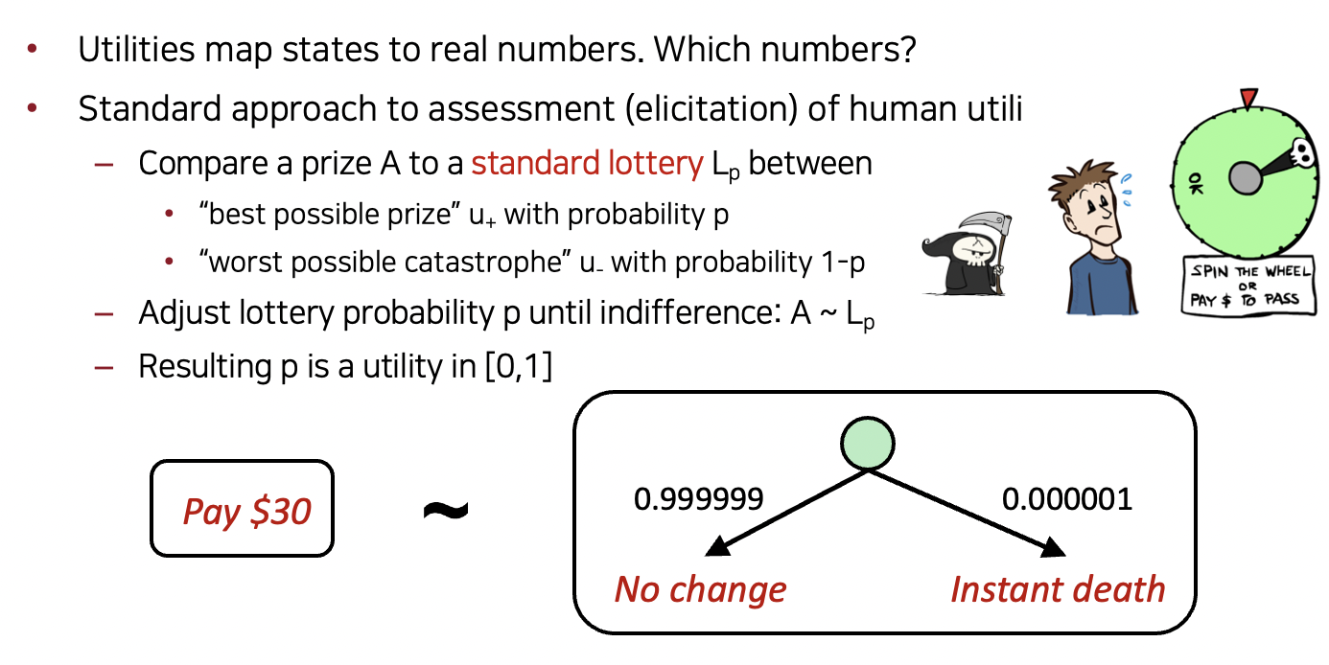
Human Utilities
Slide credit: Klein and Abbee

